Slide 1
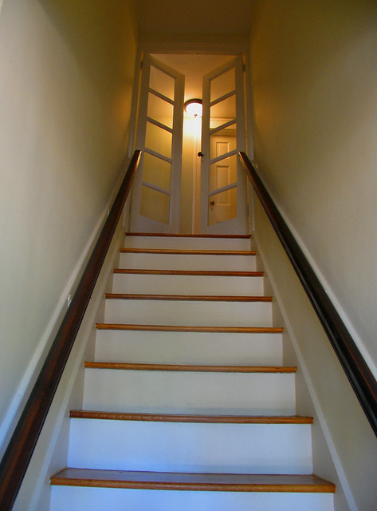
The OA Promises:
STEP BY STEP

Slide 2
The Promises we Know best
We are going to know a new freedom and a new happiness.
We will not regret the past nor wish to shut the door on it.
We will comprehend the word serenity and we will know peace.
No matter how far down the scale we have gone, we will see how our experience can benefit others.
That feeling of uselessness and self-pity will disappear.
We will lose interest in selfish things and gain interest in our fellows.
Self-seeking will slip away.
Our whole attitude and outlook upon life will change.
Fear of people and of economic insecurity will leave us.
We will intuitively know how to handle situations which used to baffle us.
We will suddenly realize that God is doing for us what we could not do for ourselves Big Book, page 83, 84

Slide 3
The promise of recovery
Lack of power, that was our dilemma. We had to find a power by which we could live, and it had to be a Power greater than ourselves. Obviously. But when and how were we to find this power? ...Well, that’s exactly what this book [the Big Book] is about. Its main object is to enable you to find a Power greater than yourself which will solve your problem. Big Book, page 45
By following these Steps, thousands of OA members have stopped eating compulsively...What works for us will work for you too. OA 12 & 12 page 1

Slide 4
About this presentation
Like every talk in OA, this is the opinion of one OA member and does not reflect OA as a whole. Take what you like and leave the rest.
It was prepared for a workshop for the MetroWest Intergroup of OA in Massachusetts, USA in 2023.
The Big Book of AA and the OA 12&12 are the sources for the promises listed here. It is not meant to be exhaustive.
The language from the literature is sometimes abbreviated or paraphrased. The page numbers are included so you can read the full accurate quote and see it in context.
I hope you find this helpful and that it inspires you to work the steps in a new or deeper way.

Slide 5
Keep This in Mind
What the Big Book says right after the 9th Step Promises:
“They are being fulfilled among us - sometimes quickly, sometimes slowly. They will always materialize if we work for them.”
We can apply this to the other promises too.
If you aren’t experiencing some of the promises, don’t despair. You are not doing the program “wrong.” Just keep working it to the very best of your ability.

Slide 6
STEP ONE We admitted we were powerless over food- that our lives had become unmanageable
The admission of our powerlessness over food opens the door to an amazing newfound power OA 12 & 12 page 6,7
We are free to change and to learn
We become teachable OA 12 & 12 page 8

Slide 7
STEP TWO Came to believe that a power greater than ourselves could restore us to sanity
As soon as we can say we believe, or are even willing to believe in a Power greater than ourselves:
We commence to get results
Upon this simple cornerstone a wonderfully effective spiritual structure can be built Big Book, page 46,47
We begin to see stability in our unbalanced lives
We begin to develop a new relationship with a power greater than ourselves OA 12&12, page 15

Slide 8
STEP THREE Made a decision to turn our will and our lives over to the care of God as we understood Him
God provides what we need if we keep close to God
We become less interested in ourselves, our little plans and designs and
we become interested in what we can contribute to life
We feel new power flow in, and we enjoy peace of mind
We discover we can face life successfully
We lose our fear of today, tomorrow, or the hereafter
We are reborn
...as long as we express the idea without reservation...an effect, sometimes a great one, is felt at once. Big Book, page 63

Slide 9
More STEP THREE
Many have a period of complete freedom from food obsession and the compulsion to overeat
Our intuition begins to function properly both about eating and the living of our lives OA 12&12, page 18
As we ask God for the willingness and ability to live within our eating guidelines, we receive first the willingness then the ability. We can count on this without fail. OA 12&12 page 21
Once we...truly take the Third step we cannot fail to recover. OA 12 and 12, page 23
When we get off track, our Higher Power will guide us back, as long as we are sincerely trying to know and do God’s will. We can confidently face any situation life brings, because we no longer have to face it alone. OA 12 and 12 (1st Edition), page 27

Slide 10
STEP FOUR Made a searching and fearless moral inventory of ourselves
To the extent that we do as we think God would have us, God enables us to match calamity with serenity.
We commence to outgrow fear. Big Book, page 68
We begin to comprehend the futility and fatality of resentments.
If we’ve been thorough about our inventory, we begin to learn tolerance, patience, and good will towards all men, even our enemies. Big Book, page 70
As we face our problems...we no longer have the need to protect ourselves from uncomfortable feelings by eating compulsively or using other destructive food behaviors...
OA 12&12 page 26
As we reach the end of Step Four, we discover that we are “moving beyond the food and the emotional havoc to a fuller living experience.” OA 12&12 page 37

Slide 11
STEP FIVE Admitted to god, to ourselves, and to another human being the exact nature of our wrongs
We can look the world in the eye.
We can be alone in perfect peace and ease.
Our fears fall from us.
We begin to feel the nearness of our Creator.
We begin to have a spiritual experience.
The feeling that our alcohol [food] problem has disappeared will often come strongly.
We feel we are walking hand in hand with the Spirit of the Universe. Big Book, page 75
We start to feel we can forgive ourselves, be forgiven, and move towards creating a new life, free from food obsession...
We begin to see reality...[and]see ourselves as capable, strong, and honest.
We begin to experience trust. OA 12&12, page 40,41

Slide 12
Step six Were entirely ready to have god remove all these defects of character
We become wiser, saner, more effective people as we recover.
...we can cope with both good times and bad, learning and growing spiritually from each experience. OA 12&12, page 49

Slide 13
STEP Seven Humbly asked Him to remove our shortcomings
Repeated practice of Step Seven enable us to form a working partnership with our HP...relieved of...defects that have blocked our effectiveness in the world.
God’s power flows surely and freely through us...drawing to us...self-esteem, a feeling of usefulness, strength to surmount difficulties, fellowship, and love. OA 12&12, page 56
If we ask, God...will remove our derelictions, but God won’t render us white as snow without our cooperation. God only asks that we try as best we know how to make progress in the building of character. Big Book, page 65

Slide 14
Step eight made a list of all persons we had harmed and became willing to make amends to them all
We can be freed of our resentments and forgive them [people who have hurt us] for the harm they have done to us...
If we keep praying for them faithfully, regardless of whether we believe a word we say, sooner or later our feelings will change. OA 12&12, page 61

Slide 15
STEP NINE Made direct amends to such people wherever possible unless to do so would injure them or others
We are going to know a new freedom and a new happiness.
We will not regret the past nor wish to shut the door on it.
We will comprehend the word serenity and we will know peace.
No matter how far down the scale we have gone, we will see how our experience can benefit others.
That feeling of uselessness and self-pity will disappear.
We will lose interest in selfish things and gain interest in our fellows.
Self-seeking will slip away.
Our whole attitude and outlook upon life will change.
Fear of people and of economic insecurity will leave us.
We will intuitively know how to handle situations which used to baffle us.
We will suddenly realize that God is doing for us what we could not do for ourselves Big Book, page 83, 84

Slide 16
More step nine
When we finish our amends:
Most of us feel closer to our Higher Power.
Our spiritual awakening has become a reality.
We are more at peace in the world.
We can face the future with a new confidence.
We no longer need the crutch of excess food because we have discovered a way of life that nourishes us physically, emotionally, and spiritually. OA 12&12, page 67

Slide 17
STEP TEN Continued to take personal inventory and when we were wrong, promptly admitted it
If we keep in fit spiritual condition:
We find we have ceased fighting anything or anyone, even alcohol [food]
Sanity will have returned
We are seldom interested in liquor [food]. If tempted, we recoil from it as from a hot flame.
We react sanely and normally, and we find this has happened automatically. Our new attitude towards liquor [food and eating] has been given to us. We are not fighting food nor avoiding temptation

Slide 18
More step ten
We feel as though we have been placed in a position of neutrality – safe and protected. The problem has been removed.
We are neither cocky or afraid.
If we have carefully followed directions, we have begun to sense the flow of...spirit into us...to some extent we have become God-conscious. We have begun to develop this vital sixth sense. Big Book, page 84, 85
God helps us to let go of our defects and replace them with positive thoughts and actions...if we persist in doing whatever we can to change. OA 12&12, page 74

Slide 19
STEP ELEVEN Sought through prayer and meditation to improve our conscious contact with God, praying only for knowledge of his will and the power to carry that out
When we ask God for inspiration, an intuitive thought or a decision, the right answers come after we have tried prayer and meditation for a while.
What used to be a hunch or occasional inspiration becomes a working part of the mind.
If we remind ourselves throughout the day that we are not running the show and say to ourselves “Thy will be done” we are in much less danger of excitement, fear, anger, worry, self-pity, or foolish decision.
We don’t tire so easily if we aren’t burning energy trying to arrange life to suit ourselves. Big Book, page 87

Slide 20
STEP TWELVE Having had a spiritual awakening as THE result of these steps...we tried to carry this message to compulsive overeaters and to practice these principles in all our affairs
We have deep and effective spiritual experiences which have revolutionized our whole attitude towards life, towards our fellows and towards God’s universe.
Our Creator enters into our hearts and minds in a miraculous way.
God commences to do for us those things we could never do for ourselves. Big Book, page 25
When the spiritual malady is overcome, we straighten out mentally and physically. Big Book, page 64

Slide 21
more STEP TWELVE Having had a spiritual awakening as THE result of these steps...we tried to carry this message to compulsive overeaters and to practice these principles in all our affairs
...we have discovered the saving strength of a Power greater than ourselves.
We have experienced the miracle of physical, emotional, and spiritual healing, just as we were promised when we began working these Steps.
We have learned a whole new set of skills for living.
We don’t have to fear anything that comes to us...we have a way of sanely facing each situation. OA 12&12, page 81,82
...when we focus on our primary objective of carrying the message of recovery, we are empowered to use our talents in ways that are truly useful to others. OA 12&12, page 123

Slide 22
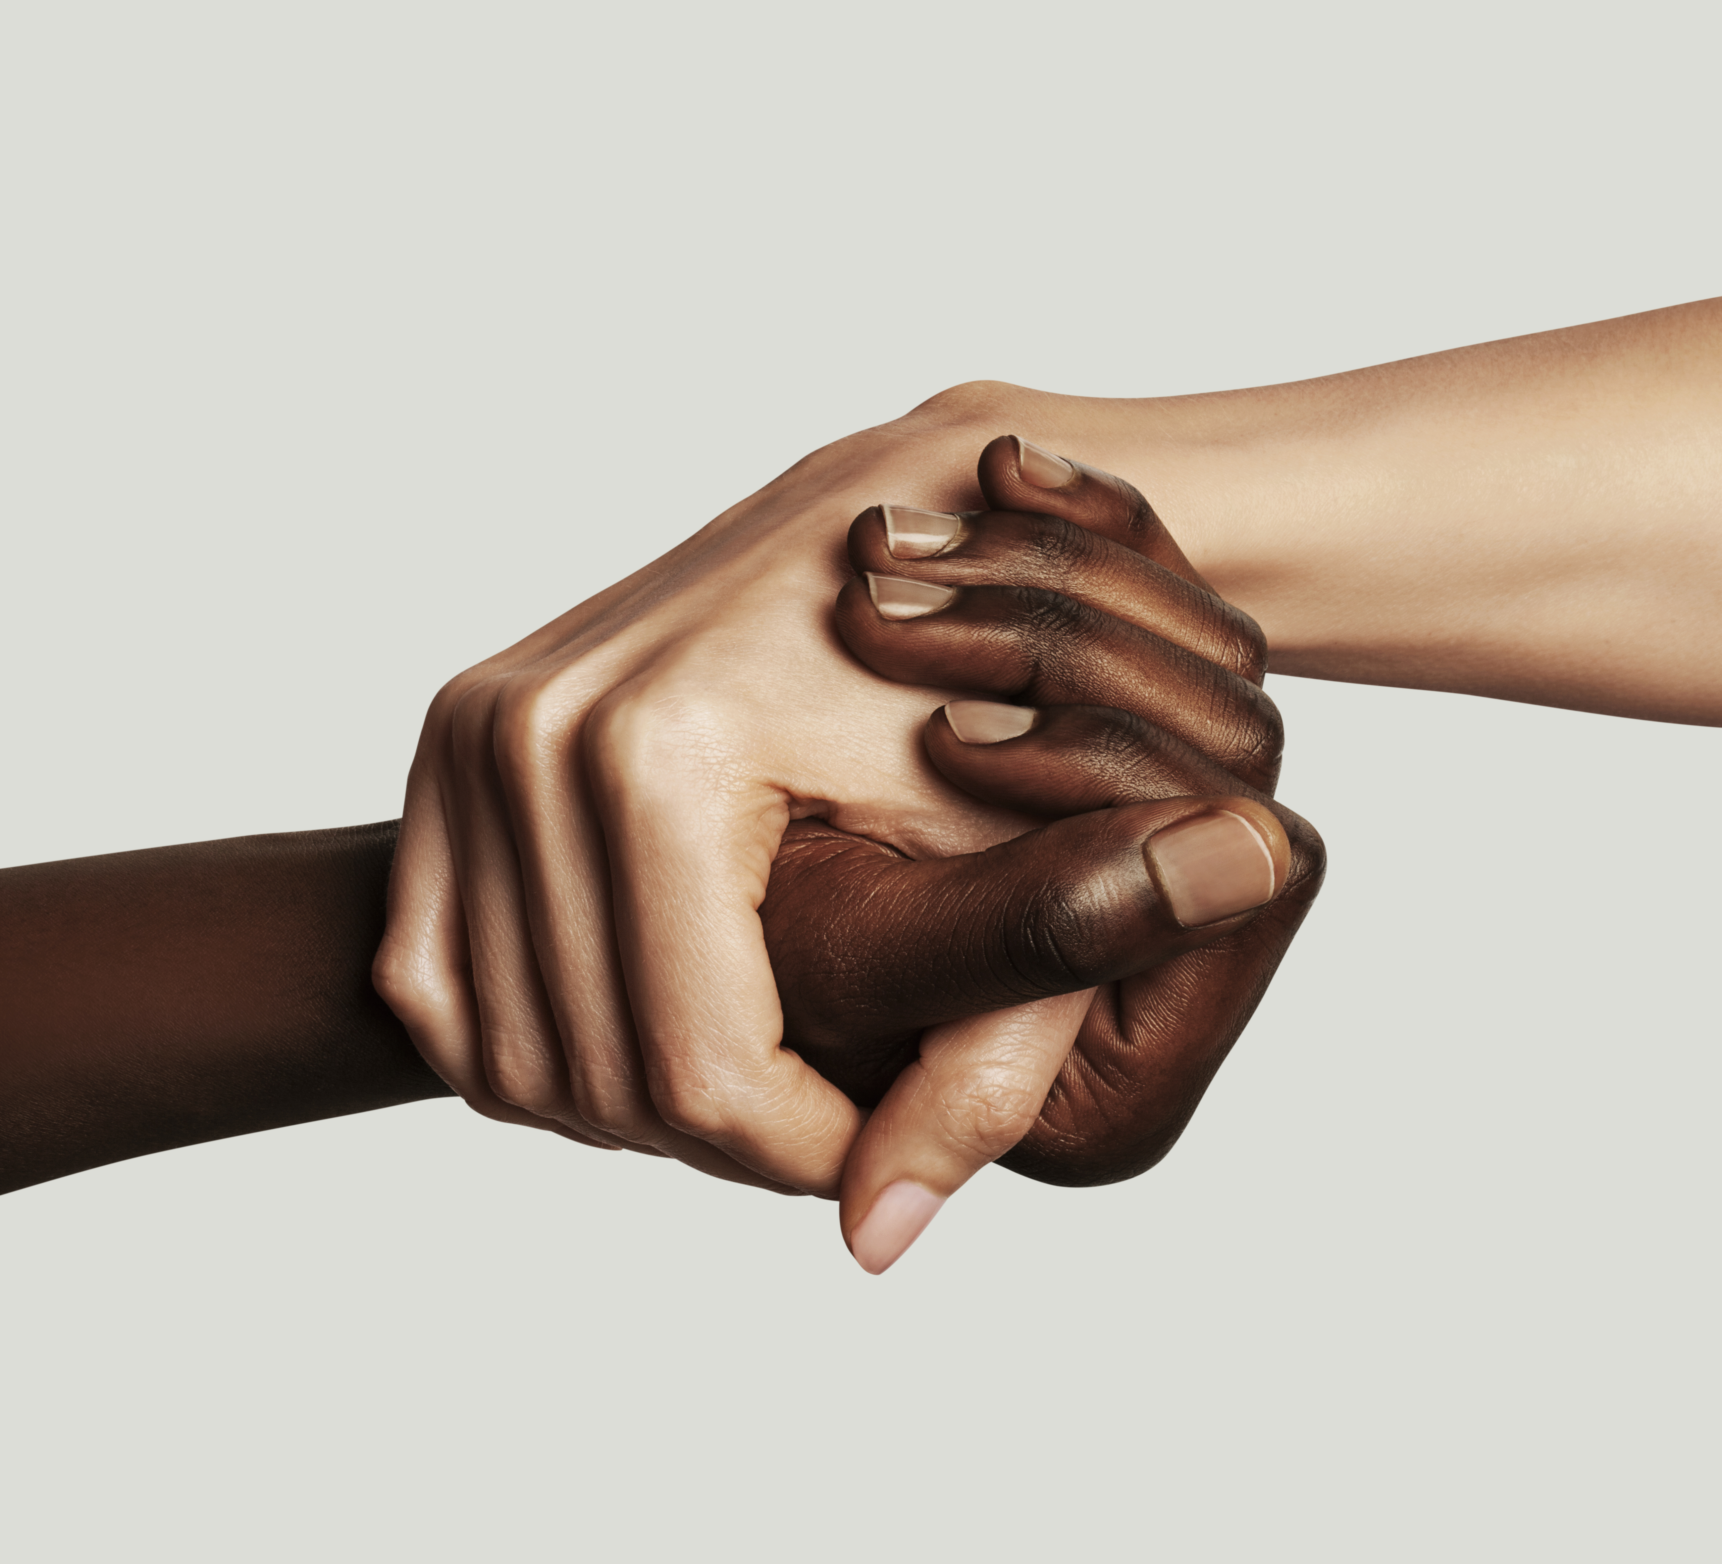
THE OA PROMISE
“I put my hand in yours, and together we can do what we could never do alone. No longer is there a sense of hopelessness, no longer must we each depend upon our own unsteady willpower. We are all together now, reaching out our hands for power and strength greater than ours, and as we join hands, we find love and understanding beyond our wildest dreams.
Rozanne S, 1968, “I Put My Hands in Yours” booklet

